Slide 1
Recursion
Chapter 7
Data Structures and Abstractions with Java, 4e Frank Carrano

Slide 2
Definition
Recursion is a problem-solving process
Breaks a problem into identical but smaller problems.
A method that calls itself is a recursive method.
The invocation is a recursive call or recursive invocation.

Slide 3
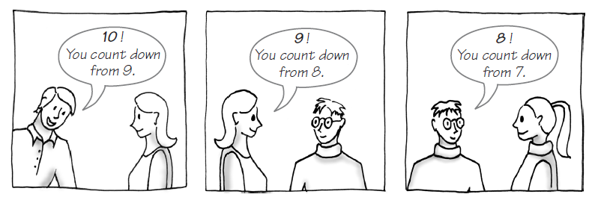
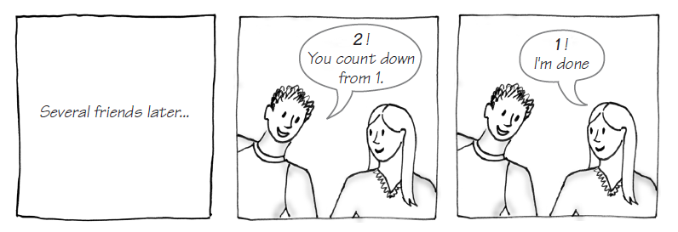
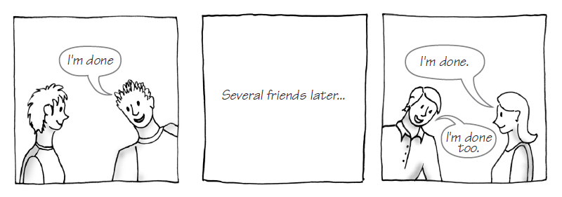
Example: The Countdown

Slide 4
Example: The Countdown
Recursive Java method to do countDown.
/** Counts down from a given positive integer.
@param integer An integer > 0.
*/
public static void countDown(int integer)
{
System.out.println(integer);
if (integer > 1)
countDown(integer - 1);
} // end countDown

Slide 5
Design Guidelines
Method must be given an input value
Method definition must contain logic that involves this input, leads to different cases
One or more cases should provide solution that does not require recursion
Else infinite recursion
One or more cases must include a recursive invocation

Slide 6
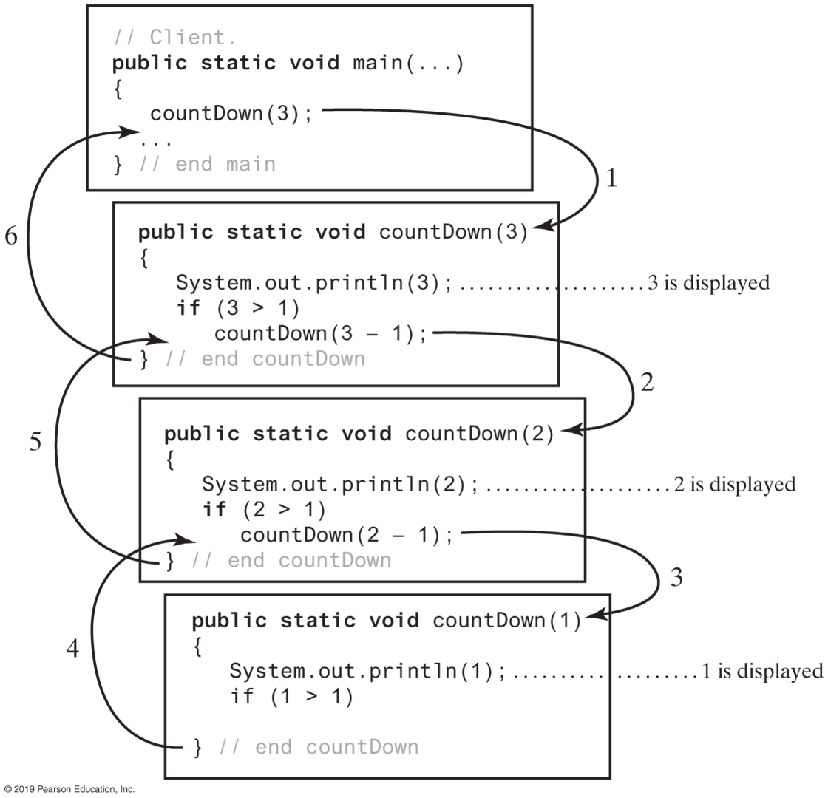
Tracing a Recursive Method

Slide 7
Stack of Activation Records
Each call to a method generates an activation record
Recursive method uses more memory than an iterative method
Each recursive call generates an activation record
If recursive call generates too many activation records, could cause stack overflow

Slide 8
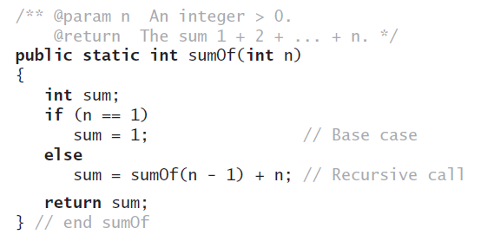

Recursive Methods That Return a Value
Recursive method to calculate

Slide 9
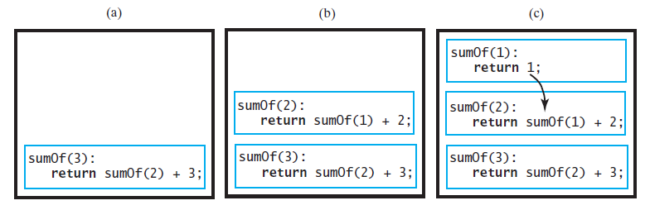
Tracing a Recursive Method
FIGURE 7-5 Tracing the execution of sumOf(3)

Slide 10
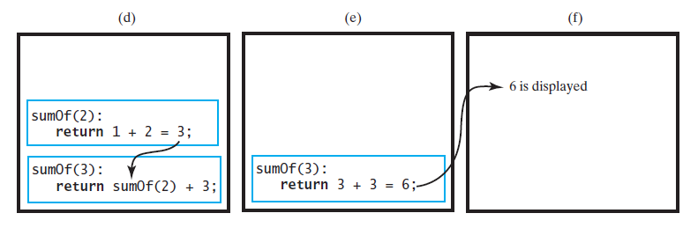
Tracing a Recursive Method
FIGURE 7-5 Tracing the execution of sumOf(3)

Slide 11
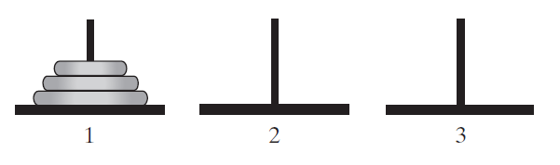
Simple Solution to a Difficult Problem
FIGURE 7-7 The initial configuration of the Towers of Hanoi for three disks.

Slide 12
Simple Solution to a Difficult Problem
Rules:
Move one disk at a time. Each disk moved must be topmost disk.
No disk may rest on top of a disk smaller than itself.
You can store disks on the second pole temporarily, as long as you observe the previous two rules.

Slide 13
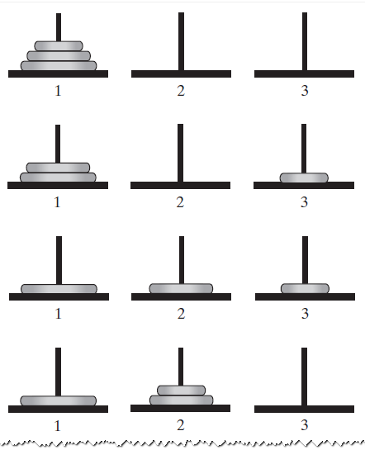
Solutions
FIGURE 7-8 The sequence of moves for solving the Towers of Hanoi problem with three disks
Notes:
http://www.algomation.com/algorithm/towers-hanoi-recursive-visualization

Slide 14
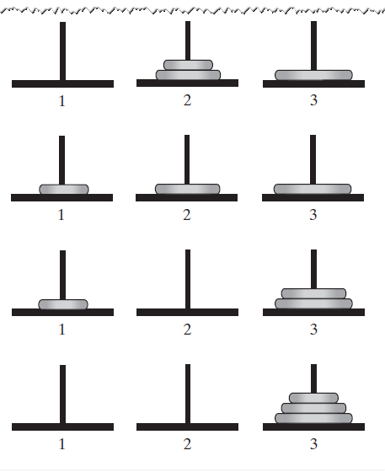
Solutions
FIGURE 7-8 The sequence of moves for solving the Towers of Hanoi problem with three disks

Slide 15
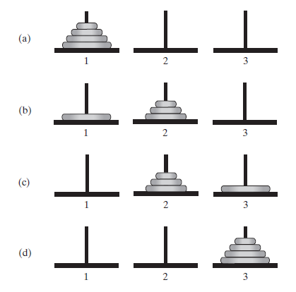
Solutions
FIGURE 7-9 The smaller problems in a recursive solution for four disks

Slide 16
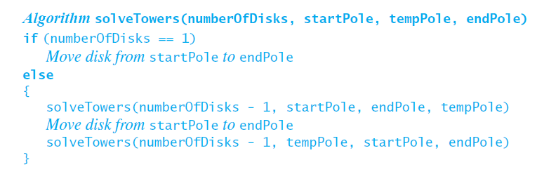
Solutions
Recursive algorithm to solve any number of disks. Note: for n disks, solution will be 2n – 1 moves

Slide 17
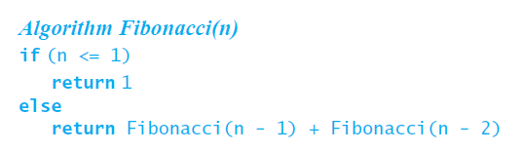
Poor Solution to a Simple Problem
Algorithm to generate Fibonacci numbers.
Why is this inefficient?

Slide 18
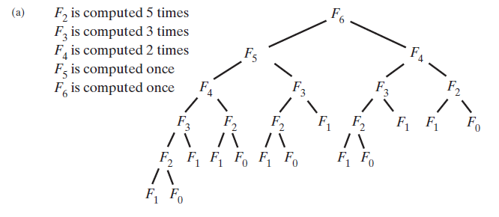
Poor Solution to a Simple Problem
FIGURE 7-10 The computation of the Fibonacci number F6 using (a) recursion … Fn = Ω(an)

Slide 19
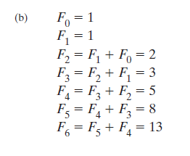
Poor Solution to a Simple Problem
FIGURE 7-10 The computation of the Fibonacci number F6 using (b) iteration.

Slide 20
Recursively Processing an Array
/** Displays the integers in an array.
@param array An array of integers.
@param first The index of the first integer displayed.
@param last The index of the last integer displayed,
0 <= first <= last < array.length. */
public static void displayArray(int[] array, int first, int last)
Given definition of a recursive method to display array.

Slide 21
Recursively Processing an Array
public static void displayArray(int array[], int first, int last)
{
System.out.print(array[first] + " ");
if (first < last)
displayArray(array, first + 1, last);
} // end displayArray
Starting with array[first]

Slide 22
Recursively Processing an Array
public static void displayArray(int array[], int first, int last)
{
if (first <= last)
{
displayArray(array, first, last - 1);
System.out.print(array[last] + " ");
} // end if
} // end displayArray
Starting with array[last]

Slide 23
Recursively Processing an Array
public static void displayArray(int array[], int first, int last)
{
if (first == last)
System.out.print(array[first] + " ");
else
{
int mid = first + (last - first) / 2;
displayArray(array, first, mid);
displayArray(array, mid + 1, last);
} // end if
} // end displayArray
Why?
Processing array from middle.

Slide 24
Tail Recursion
In a tail-recursive method, the last action is a recursive call
This call performs a repetition that can be done by using iteration.
Converting a tail-recursive method to an iterative one is usually a straightforward process.

Slide 25
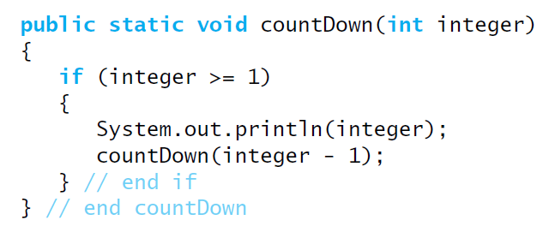
Tail Recursion
When the last action performed by a recursive method is a recursive call.

Slide 26
Indirect Recursion
Example
Method A calls Method B
Method B calls Method C
Method C calls Method A
Difficult to understand and trace
But does happen occasionally

Slide 27
End
Chapter 7

Slide 28
An Introduction to Sorting
Chapter 8
Data Structures and Abstractions with Java, 4e Frank Carrano

Slide 29
Sorting
We seek algorithms to arrange items, ai such that entry 1 ≤ entry 2 ≤ . . . ≤ entry n
Sorting an array is usually easier than sorting a chain of linked nodes
Efficiency of a sorting algorithm is significant

Slide 30
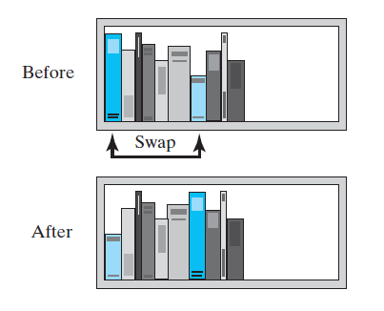
Selection Sort
FIGURE 8-1 Before and after exchanging the shortest book and the first book

Slide 31
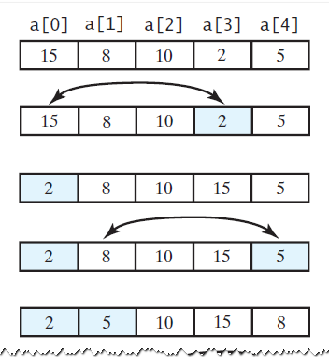
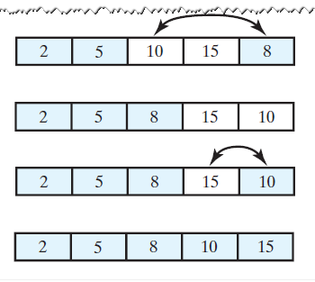
Selection Sort
FIGURE 8-2 A selection sort of an array of integers into ascending order

Slide 32
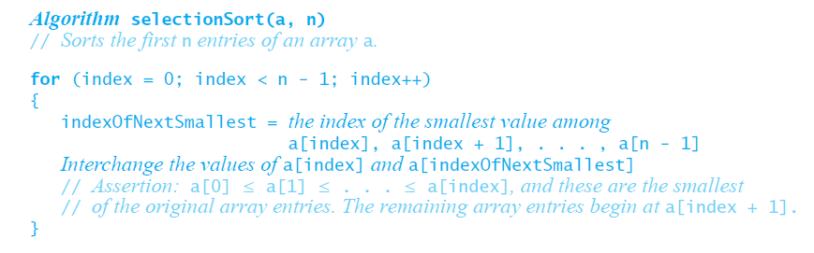
Iterative Selection Sort
This pseudocode describes an iterative algorithm for the selection sort

Slide 33
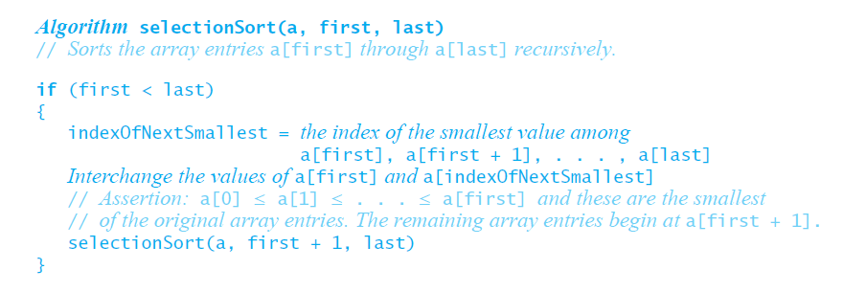
Recursive Selection Sort
Recursive selection sort algorithm

Slide 34
Efficiency of Selection Sort
Selection sort is O(n2) regardless of the initial order of the entries.
Requires O(n2) comparisons
Does only O(n) swaps

Slide 35
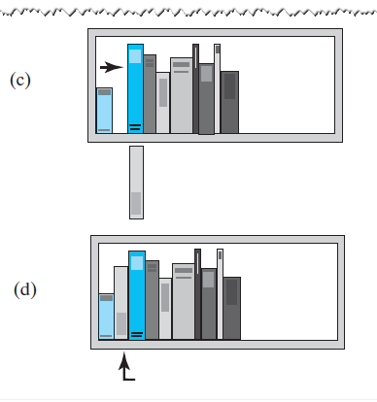
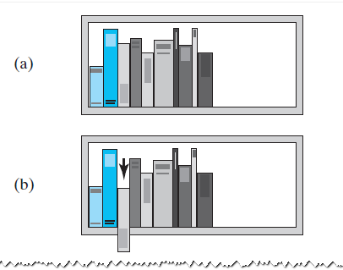
Insertion Sort
FIGURE 8-3 The placement of the third book during an insertion sort

Slide 36
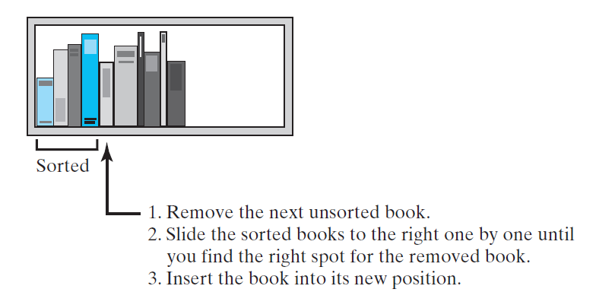
Insertion Sort
FIGURE 8-4 An insertion sort of books

Slide 37
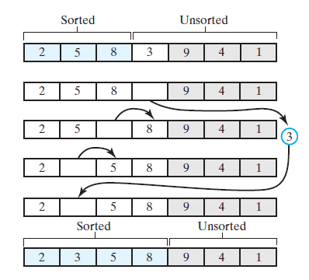
Iterative Insertion Sort
FIGURE 8-5 Inserting the next unsorted entry into its proper location within the sorted portion of an array during an insertion sort

Slide 38
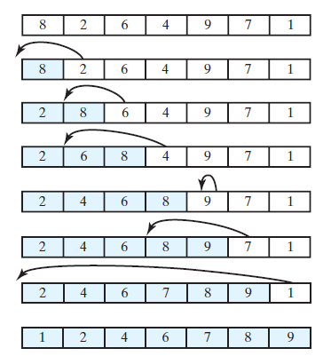
Iterative Insertion Sort
FIGURE 8-6 An insertion sort of an array of integers into ascending order

Slide 39
Iterative Insertion Sort
Algorithm insertionSort(a, first, last)
// Sorts the array entries a[first] through a[last] iteratively.
for (unsorted = first + 1 through last)
{
nextToInsert = a[unsorted]
insertInOrder(nextToInsert, a, first, unsorted − 1)
}
Iterative algorithm describes an insertion sort of the entries at indices first through last of the array a

Slide 40
Iterative Insertion Sort
Algorithm insertInOrder(anEntry, a, begin, end)
// Inserts anEntry into the sorted entries a[begin] through a[end].
index = end // Index of last entry in the sorted portion
// Make room, if needed, in sorted portion for another entry
while ( (index >= begin) and (anEntry < a[index]) )
{
a[index + 1] = a[index] // Make room
index−−
}
// Assertion: a[index + 1] is available.
a[index + 1] = anEntry // Insert
Pseudocode of method, insertInOrder, to perform the insertions.

Slide 41
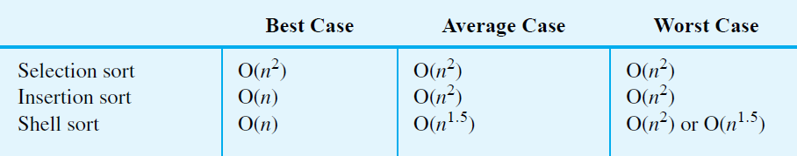
Comparing the Algorithms
FIGURE 8-16 The time efficiencies of three sorting algorithms, expressed in Big Oh notation

Slide 42
End
Chapter 8

